Slide 1
AWS EC2 Instance
Presented by Shirisha

Slide 2


Slide 3
What is EC2
EC2 stand for elastic cloud compute , is a web service that provides on demand computing capacity in the AWS cloud.
It is essentially allows users to rent virtual machines, called instances, to run their applications.
Using Amazon EC2 reduces hardware costs so you can develop and deploy applications faster.

Slide 4
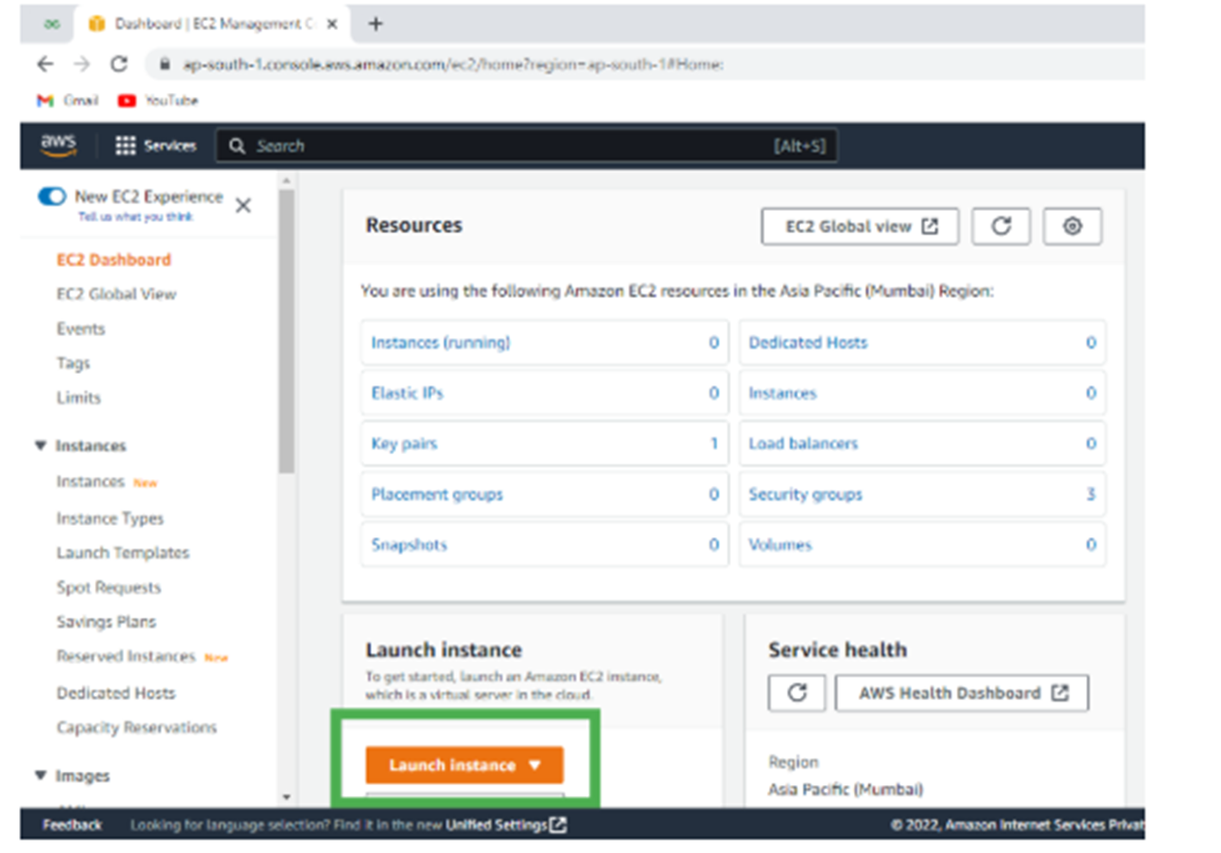

Slide 5
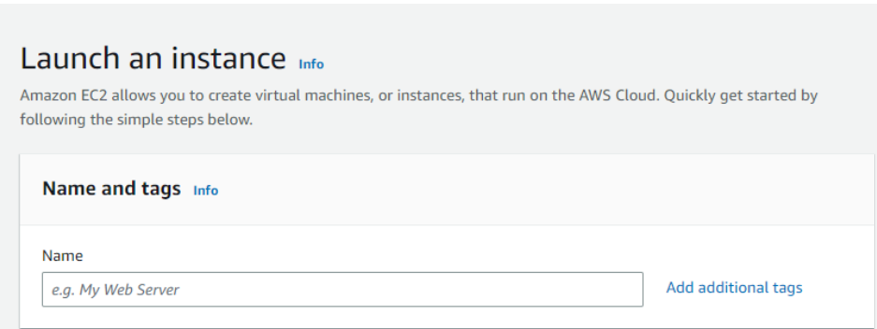
Steps to Launch the EC2 Instance (free tier) using New Portal
How to Create EC2 Instance in AWS (Amazon)
Step 1: Login and Navigate to EC2 Dashboard.
Step 2: Launch a New Instance.

Slide 6
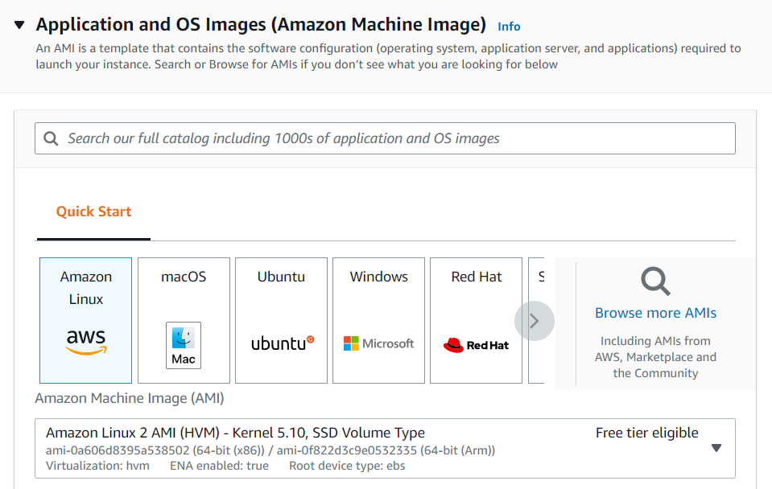
Step 3: Choose Amazon Machine Image Select AMI - Required operating system from the available. This AMI includes all the things which are required for the application like operating system, software and settings to create your own customized EMI. Creating your own customized AMI will makes it easier to deploy the application in the EC2 instance

Slide 7
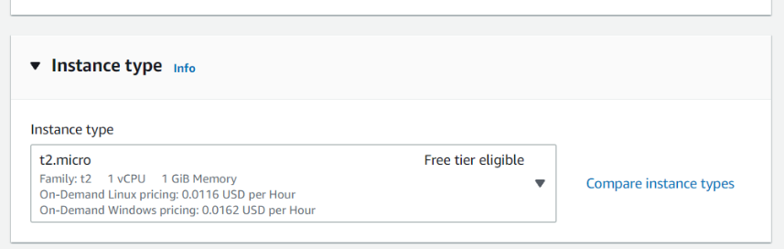
Step 4: Select Instance Type The instance type includes the no.of CPUs required and the Memory required for your application. By default, the instance type is "t2.micro" which is a free tier-eligible service. Do not select any other which leads to the billing amount.

Slide 8
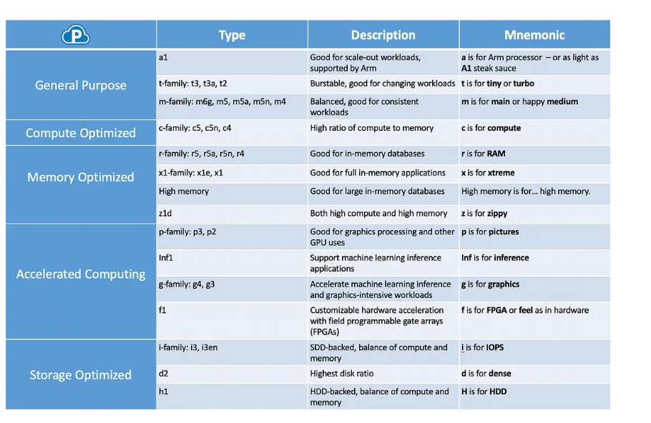
EC2 Instance types

Slide 9
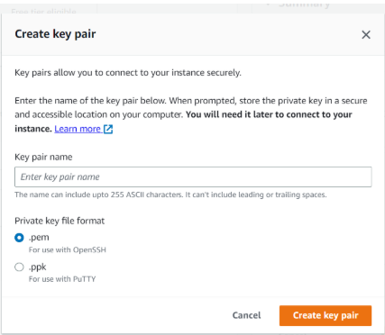
step 5: Configure Key Pair Now, create a key-value pair, by clicking on "Create new key pair". A window will pop up for creating key pair as shown below. The key value pair plays a major role while connecting to the EC2-Instance it will act as an SSH-Key to connect to the instance. Create Key-Pair Enter name>>Select ".pem" and create. Automatically key pair which was created will be downloaded. Select the created key pair

Slide 10
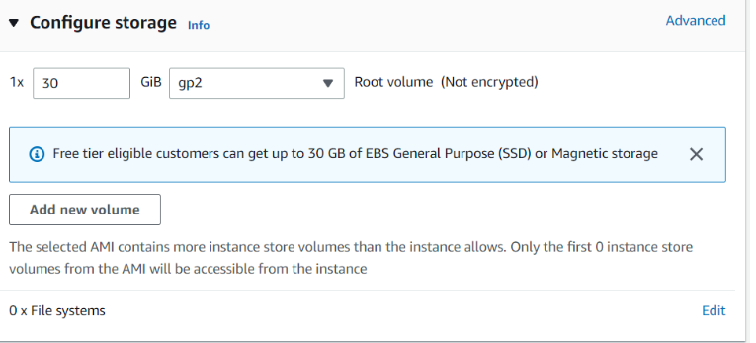
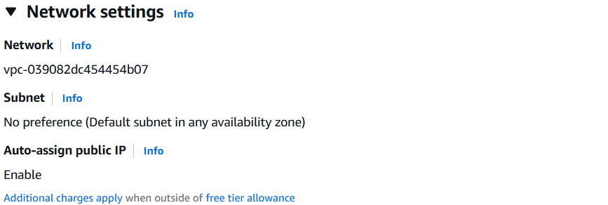
Step 6: Network and Storage Configuration Keep the network settings as default settings and make changes if required. Storage As mentioned in the picture, Free tier eligible can get up to 30 GB of EBS Storage. Keep it as default.

Slide 11
Elastic block storage
It is a high-performance, block-level storage service offered by AWS that provides persistent storage volumes for Amazon EC2 instances
It allows you to create virtual hard drives in the cloud that can be attached to and detached from EC2 instances, just like you would with a physical hard drive.

Slide 12
Snapshot In AWS, a snapshot is a point-in-time copy of an EBS (Elastic Block Store) volume, serving as a backup mechanism. It allows you to restore your volume to a previous state, replicate data across regions, and improve data durability and availability. Snapshots can be automated, encrypted, and copied across regions.

Slide 13
EC2 Purchasing Options : 1.On-Demand Instances: Pay for compute capacity by the hour or second with no long-term commitments. Use Case: Ideal for short-term, unpredictable workloads or for testing and development environments .Pros: Flexibility without upfront costs .Cons: Higher cost compared to other options. 2.Reserved Instances: Commit to a specific instance type and region for a one- or three-year term in exchange for a significant discount. Use Case: Suitable for applications with steady-state usage. Pros: Up to 72% cost savings over On-Demand pricing. Cons: Less flexibility; commitment required. 3.Spot Instances: Description: Purchase unused EC2 capacity at reduced rates, with the possibility of interruption. Use Case: Best for fault-tolerant, flexible applications like batch processing or development/testing environments. Pros: Up to 90% cost savings over On-Demand pricing. Cons: Instances can be terminated by AWS with little notice

Slide 14
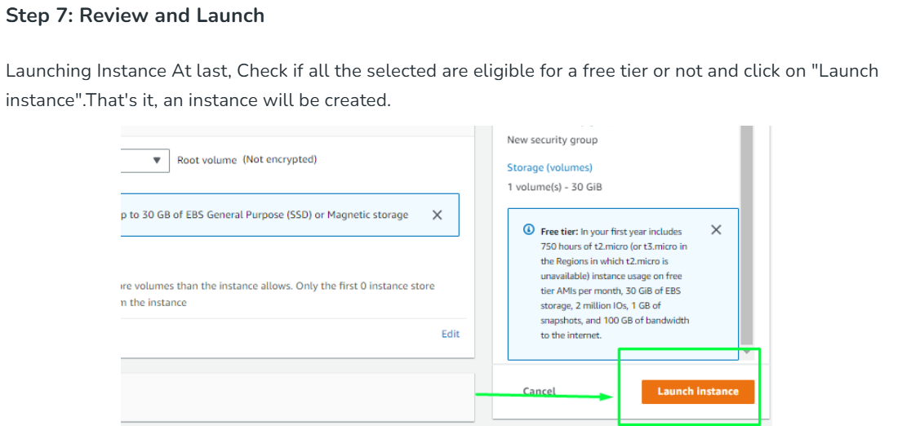

Slide 15
USER DATA (OR)BOOT STRAPPING
ALONG WITH THE INSTANCE ,IF I WANT TO LAUNCH ANY APACHE TOMCAT,GIT,JAVA,I AM MENTION THE SCRIPT OVER THERE.
PASSWORDLESS AUTHENTICATIONSTEP
STEP1-SSH-KEYGEN STEP 2-CAT/C/USER/ID-RSA PUB STEP 3-LOGIN INTO THE INSTANCE STEP 4-CD. SSH STEP 5-LS
VI AUTHORIZED KEY

Slide 16
Advantages of AWS EC2-Instances
EC2 instances can be easily scaled up or down as per the requirement, providing a highly scalable and flexible infrastructure.
EC2 instances are charged based on usage, making it cost-effective as you only pay for what you use.
It can be easily deployed and managed using Amazon Web Services (AWS) management console, APIs, or CLI.
It can be deployed in multiple availability zones to ensure high availability and data durability.
It can be customized with different operating systems, applications, and network configurations.

Slide 17
Disadvantages of AWS EC2-Instances
EC2 instances have limited customization options, which may not be sufficient for some applications.
It can be expensive, especially when scaling up, and it can be challenging to control costs.
This is vulnerable to security risks, such as unauthorized access, data breaches, and cyberattacks.
EC2 instances can be complex to set up and manage, especially for non-technical users.
It may experience latency due to the location of the instances and the data center, which can affect application performance.

Slide 18
Conclusion
EC2 instances are a foundational cloud computing service, offering scalable and flexible compute power to run applications and services. They provide a cost-effective and efficient way to manage resources by allowing you to scale up or down as needed
EC2 instances are a key component of the AWS ecosystem

Slide 19
Thank You

